Slide 1
Chapter 5 – Evaluating Classification & Predictive Performance
Data Mining for Business Analytics in R
Shmueli, Bruce, Yahav, Patel & Lichtendahl

Slide 2

Why Evaluate?
Multiple methods are available to classify or predict
For each method, multiple choices are available for settings
To choose best model, need to assess each model’s performance

Slide 3
Evaluation of Supervised Learning
Predicted Numerical Value. E.g., House price
Predicted Class Membership. E.g., buyer/nonbuyer
Propensity. i.e., propensity of class membership. E.g., propensity to default

Slide 4
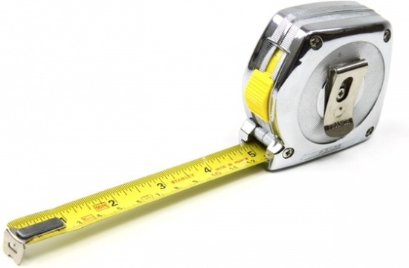
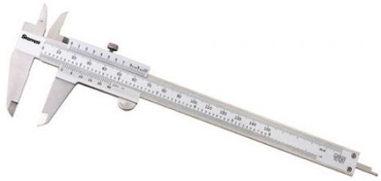
Evaluating Predictive Performance

Slide 5
Measuring Predictive error
Not the same as “goodness-of-fit”
We want to know how well the model predicts new data, not how well it fits the data it was trained with
Key component of most measures is difference between actual y and predicted y (“error”)

Slide 6
Some measures of error
MAE or MAD: Mean absolute error (deviation)
Gives an idea of the magnitude of errors
Mean Error
Gives an idea of systematic over- or under-prediction
MPE: Percentage deviation from actual on average
MAPE: Mean absolute percentage error
RMSE (root-mean-squared-error): Square the errors, find their average, take the square root
Notes:
There isn't a strict rule of thumb to determine which accuracy metric (MAE, MAPE, RMSE, etc.) is universally better than the others, as the choice of metric depends on the specific characteristics of your data, your forecasting goals, and the nature of the problem you are solving. Each metric has its own advantages and limitations, and the choice often comes down to what aspect of forecasting performance you want to emphasize.
Mean Absolute Error (MAE):
Advantage: It is easy to interpret and is less sensitive to extreme outliers.
Consideration: It treats overestimations and underestimations equally. If overestimations and underestimations have different costs or implications in your application, MAE may not reflect that.
Mean Absolute Percentage Error (MAPE):
Advantage: It provides a percentage error, which can be helpful for understanding the relative magnitude of errors.
Consideration: It can be problematic when actual values are close to or equal to zero, as it can result in undefined or very large values. It also treats overestimations and underestimations equally.
Root Mean Squared Error (RMSE):
Advantage: It penalizes larger errors more heavily than smaller errors, which can be appropriate if you want to emphasize the importance of reducing large errors.
Consideration: It tends to be sensitive to outliers and can be influenced by extreme values.
Mean Absolute Error (MAE): MAE measures the average absolute difference between the predicted values and the actual values. It is robust and easy to interpret, making it useful in various scenarios.
Inventory Management:
Business Case: A retail company wants to optimize its inventory management. They use a multiple linear regression model to predict the demand for various products.
Use of MAE: MAE is used to assess the accuracy of the demand predictions. It helps the company understand, on average, how far off their predictions are from the actual demand. This information is crucial for maintaining appropriate inventory levels without overstocking or understocking.
Energy Consumption Forecasting:
Business Case: An energy utility company aims to forecast electricity consumption for different regions to efficiently allocate resources and generate electricity.
Use of MAE: MAE is used to evaluate the accuracy of the consumption forecasts. It provides a measure of how much the predicted consumption values deviate, on average, from the actual consumption. Accurate predictions are vital for efficient resource allocation and cost management.
Mean Absolute Percentage Error (MAPE): MAPE measures the average percentage difference between the predicted values and the actual values, making it useful for understanding the relative error in predictions.
Sales Forecasting for Retailers:
Business Case: A retail chain wants to forecast sales for various products and store locations to optimize inventory, staffing, and marketing strategies.
Use of MAPE: MAPE is employed to assess the accuracy of sales forecasts in percentage terms. It helps the retailer understand how closely their predictions align with actual sales, allowing them to fine-tune inventory, staffing, and promotional efforts.
Financial Portfolio Management:
Business Case: An investment firm uses multiple linear regression to predict the returns of various financial assets within a portfolio.
Use of MAPE: MAPE is used to measure the accuracy of return predictions as a percentage error. This metric helps the firm assess the reliability of its asset return forecasts, assisting in portfolio optimization and risk management.
Root Mean Squared Error (RMSE): RMSE measures the square root of the average squared differences between the predicted and actual values. It emphasizes larger errors more than smaller ones and is widely used in various fields.
Real Estate Price Prediction:
Business Case: A real estate agency builds a multiple linear regression model to predict property prices based on features like location, size, and amenities.
Use of RMSE: RMSE is employed to evaluate the model's accuracy in predicting property prices. It provides insight into the magnitude of errors in price predictions, helping buyers and sellers make informed decisions.
Manufacturing Quality Control:
Business Case: A manufacturing company uses regression to predict product quality based on process parameters. High-quality products lead to cost savings and customer satisfaction.
Use of RMSE: RMSE is used to measure the accuracy of quality predictions. It highlights deviations from expected quality levels, allowing the company to identify and address process issues that affect product quality.

Slide 7
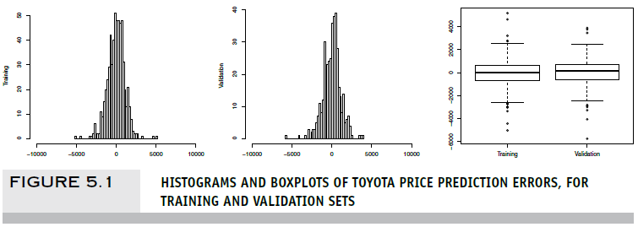
Prediction Error
Notes:
Training Data:
ME (Mean Error):
-9.73e-12 (essentially 0): This value is very close to 0, meaning that on average, the model does not have a systematic bias in the training data (i.e., it is not consistently under-predicting or over-predicting).
A value close to 0 is good because it indicates that, on average, the predictions are balanced between over- and under-prediction.
RMSE (Root Mean Squared Error):
958.95: This metric measures the average magnitude of the prediction errors, penalizing larger errors more than smaller ones. A lower RMSE means the model fits the data better, but RMSE can be sensitive to outliers.
958.95 means that, on average, the model's predictions on the training set are off by approximately $959.
MAE (Mean Absolute Error):
747.39: This is the average of the absolute errors, and it is generally easier to interpret than RMSE because it does not penalize larger errors disproportionately. In this case, the average prediction error is around $747 on the training set.
MPE (Mean Percentage Error):
-0.67%: This indicates that, on average, the model underestimates the price by 0.67% on the training set. The negative sign shows a slight tendency to under-predict the actual values.
MAPE (Mean Absolute Percentage Error):
7.42%: This metric expresses the error as a percentage of the actual value. On average, the model's predictions are off by around 7.42% of the actual car price.
Validation Data:
ME (Mean Error):
-0.34: Again, this value is close to 0, indicating that there is no significant bias in the predictions on the validation set. The model is not systematically over-predicting or under-predicting on unseen data.
RMSE (Root Mean Squared Error):
1350.15: The RMSE on the validation set is higher than on the training set (1350.15 vs. 958.95), suggesting that the model does not generalize as well to unseen data. However, this is not an unusual discrepancy, as the model is expected to perform slightly worse on validation data.
The error of 1350 units indicates a larger average deviation from the actual prices compared to the training set.
MAE (Mean Absolute Error):
901.33: The average absolute error is also higher on the validation set than on the training set (901.33 vs. 747.39). This again indicates that the model is performing worse on unseen data, but the difference is not extreme.
MPE (Mean Percentage Error):
-1.12%: The model slightly underestimates the prices by 1.12% on average in the validation set, a slightly higher under-prediction bias than on the training set.
MAPE (Mean Absolute Percentage Error):
9.49%: The average prediction error on the validation set is 9.49%, which is higher than the training set (7.42%). This indicates that the model is less accurate on unseen data but still within a reasonable range for many applications.
Key Observations and Interpretation:
Generalization:
The model's performance is slightly worse on the validation set than on the training set, which is expected in most cases because the model has not seen the validation data during training.
The RMSE increased from 959 on the training set to 1350 on the validation set, and the MAPE increased from 7.42% to 9.49%. While there is a performance drop, this is not extreme, which suggests the model generalizes reasonably well.
Overfitting:
The increase in error metrics on the validation set could indicate some degree of overfitting, but the difference is not too large. If the validation errors had been much higher than the training errors, it would suggest overfitting, but here the model seems to be performing fairly well.
Bias:
The MPE values are slightly negative for both the training and validation sets, indicating a small bias toward under-predicting car prices. However, the bias is minor (around 0.67% and 1.12%, respectively) and likely not a major concern.
Accuracy:
The MAPE on the validation set is 9.49%, meaning that on average, the model's predictions are within 9.5% of the actual prices. Depending on the business context, this level of accuracy might be acceptable or might indicate the need for improvement.

Slide 8
Lift Chart for Predictive Error
Y axis is cumulative value of numeric target variable (e.g., revenue), instead of cumulative count of “responses”
X axis is cumulative number of cases, sorted left to right in order of predicted value
Benchmark is average numeric value per record, i.e. not using model

Slide 9
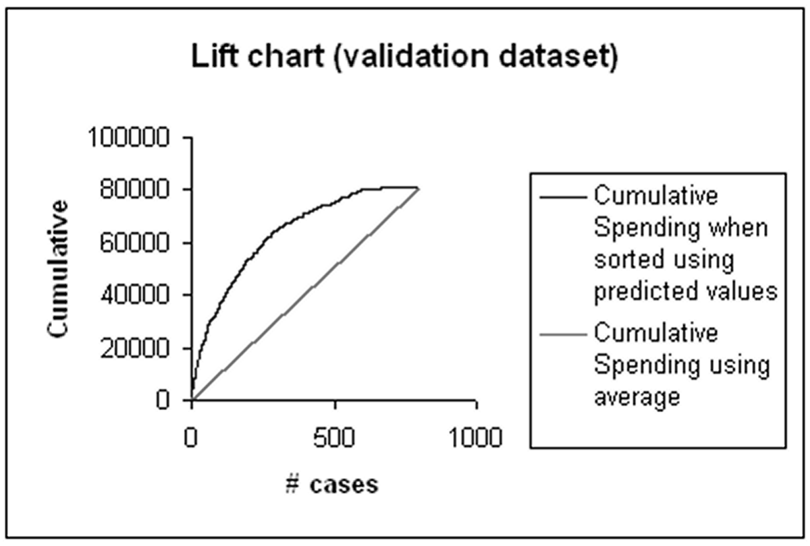
Lift chart example – spending

Slide 10
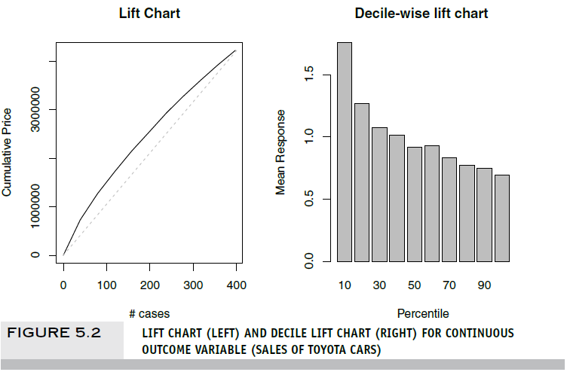
Lift Chart & Decile-wise Lift Chart
Notes:
A lift chart for a continuous response is relevant only when we are searching for a set of records that gives the highest cumulative predicted values.
A lift chart is not relevant if we are interested in predicting the outcome value for each new record.
Decile-wise lift chart:
gain$mean.resp / mean(price):
gain$mean.resp: This is a vector that contains the mean response (e.g., the average predicted value or the proportion of positive cases) within each decile of the population.
mean(price): This is the overall average price (or response) in the entire dataset.
gain$mean.resp / mean(price): This computes the lift by comparing the mean response within each decile to the overall mean response. The lift tells you how much better the model is at identifying the desired outcome compared to random selection.
A lift greater than 1 indicates that the model is doing better than random selection at identifying the top-performing deciles.

Slide 11
Accuracy Measures (Classification)

Slide 12
Misclassification error
Error = classifying a record as belonging to one class when it belongs to another class.
Error rate = percent of misclassified records out of the total records in the validation data
Notes:
A natural criterion for judging the performance of a classifier is the probability of making a misclassification error. Misclassification means that the record belongs to one class but the model classifies it as a member of a different class.

Slide 13
Naïve Rule
Naïve rule: classify all records as belonging to the most prevalent class
Often used as benchmark: we hope to do better than that
Exception: when goal is to identify high-value but rare outcomes, we may do well by doing worse than the naïve rule (see “lift” – later)
Notes:
Benchmark… baseline.
Similar to using the sample mean as the naive benchmark in the numerical outcome case, the naive rule for classification relies solely on the y information and excludes any additional predictor information.

Slide 14
Separation of Records
“High separation of records” means that using predictor variables attains low error
“Low separation of records” means that using predictor variables does not improve much on naïve rule
Notes:
It refers to the degree to which different classes or categories in a dataset can be distinctly and accurately separated from one another based on the features or attributes of the data.
In simpler terms, it measures how well a machine learning algorithm can distinguish between different classes.
Scatter plots to visualize
the terms "high separation of records" and "low separation of records" are used to describe the discriminative power of predictor variables in a binary classification context. High separation indicates that the model can make accurate predictions with low error, while low separation suggests that the model's predictions are not significantly better than a basic rule or random chance. These concepts are important for assessing the quality of a classification model and understanding the relationship between predictors and outcomes.

Slide 15
Class Separation
Notes:
Class Separation
If the classes are well separated by the predictor information, even a small dataset will suffice in finding a good classifier, whereas if the classes are not separated at all by the predictors, even a very large dataset will not help. Figure 5.3 illustrates this for a two-class case. The top panel includes a small dataset (n = 24 records) where two predictors (income and lot size) are used for separating owners from nonowners [we thank Dean Wichern for this example, described in Johnson and Wichern (2002)]. Here, the predictor information seems useful in that it separates the two classes (owners/nonowners). The bottom panel shows a much larger dataset (n = 5000 records) where the two predictors (income and monthly average credit card spending) do not separate the two classes well in most of the higher ranges (loan acceptors/nonacceptors).

Slide 16
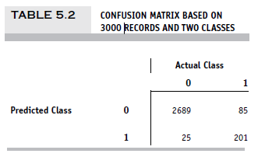
Confusion Matrix (R function: “confusionMatrix”)
201 1’s correctly classified as “1”
85 1’s incorrectly classified as “0”
25 0’s incorrectly classified as “1”
2689 0’s correctly classified as “0”
Notes:
In practice, most accuracy measures are derived from the confusion matrix, also called classification matrix.

Slide 17
Error Rate
Overall error rate = (25+85)/3000 = 3.67%
Accuracy = 1 – err = (201+2689) = 96.33%
If there are multiple classes, the error rate is:
(sum of misclassified records)/(total records)

Slide 18
Cutoff for classification
Most DM algorithms classify via a 2-step process:
For each record,
Compute probability of belonging to class “1”
Compare to cutoff value, and classify accordingly
Default cutoff value is 0.50
If >= 0.50, classify as “1”
If < 0.50, classify as “0”
Can use different cutoff values
Typically, error rate is lowest for cutoff = 0.50
Notes:
Flexibility with Cutoff:
Cutoff can be changed: Depending on the specific problem and the trade-off between precision and recall, the cutoff value can be adjusted. For example:
A higher cutoff (e.g., 0.7) may be used if you want to be more confident before predicting class 1 (e.g., detecting cancer, where false positives need to be minimized).
A lower cutoff (e.g., 0.3) might be used when it’s more important to capture all positives, even if it means allowing more false positives (e.g., fraud detection).
Error Rate and Cutoff:
Error rate is typically lowest at a cutoff of 0.50 in balanced datasets, where the classes are equally distributed. However, this isn't always true for imbalanced datasets where the proportion of class 1 and class 0 is very different.
For imbalanced datasets, choosing a cutoff of 0.50 might not yield the best classification performance, and the cutoff may need to be optimized to minimize error, precision-recall trade-offs, or to account for cost-sensitive learning (e.g., minimizing false negatives in fraud detection).
Why Adjust Cutoff:
Precision vs. Recall Trade-off: In many cases, the choice of cutoff affects the balance between precision (how many of the predicted positives are truly positive) and recall (how many actual positives are correctly identified). For example:
A lower cutoff can increase recall but decrease precision.
A higher cutoff can increase precision but decrease recall.
Domain-Specific Needs: For certain applications like medical diagnostics or credit card fraud detection, the costs of false positives vs. false negatives differ, and adjusting the cutoff allows the model to prioritize the more important metric.
Lead Scoring: In sales and marketing, lead scoring models assign a propensity score to potential customers, indicating their likelihood of making a purchase. By setting a cutoff value, marketing teams can focus their efforts on leads with high propensity scores, considering them as "hot leads" for follow-up.
Customer Churn Prediction: In customer churn prediction, a propensity score is assigned to each customer, representing their likelihood to churn. A cutoff value can be defined to classify customers as "at risk" of churning if their propensity score exceeds the threshold.
Credit Risk Assessment: Credit risk models assign propensity scores to loan applicants, indicating their likelihood of defaulting on a loan. Lenders set a cutoff value to decide which applicants are considered high-risk and may be denied loans or charged higher interest rates.
Direct Marketing: In direct marketing campaigns, propensity models are used to identify individuals likely to respond positively to an offer. By setting a cutoff, marketers can target those individuals with high propensity scores, increasing the chances of a positive response.
Fraud Detection: In fraud detection, propensity scores are assigned to financial transactions to assess their likelihood of being fraudulent. A cutoff value is used to classify transactions as "suspicious" or "non-suspicious" based on their propensity scores.
Employee Attrition Prediction: HR departments use propensity models to predict employee attrition. Employees with propensity scores above a cutoff may be identified as at risk of leaving the company, prompting retention efforts.
Cross-Selling and Upselling: In retail, propensity models help identify customers likely to purchase additional products or upgrade their services. By setting a cutoff, retailers can target high-propensity customers with tailored offers.
Healthcare Interventions: Healthcare providers use propensity models to identify patients at risk of specific health conditions. A cutoff value can help determine which patients should receive early interventions or screenings.

Slide 19
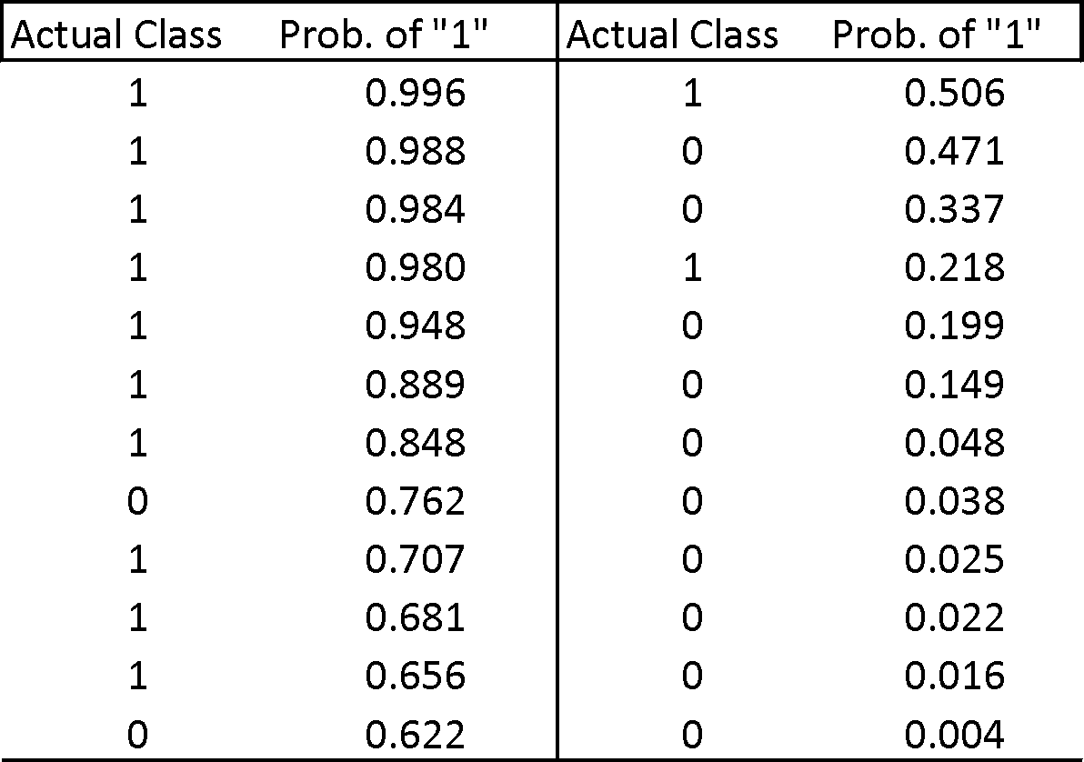
Cutoff Table
If cutoff is 0.50: eleven records are classified as “1”
If cutoff is 0.80: seven records are classified as “1”

Slide 20
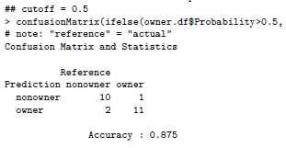
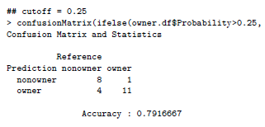
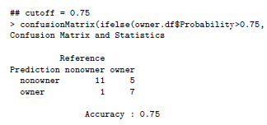
Confusion Matrix for Different Cutoffs
Function confusionMatrix requires library caret

Slide 21
When One Class is More Important
In many cases it is more important to identify members of one class
Tax fraud
Credit default
Response to promotional offer
Detecting electronic network intrusion
Predicting delayed flights
In such cases, we are willing to tolerate greater overall error, in return for better identifying the important class for further attention
Notes:
The costs of misclassification might be asymmetric.

Slide 22
Alternate Accuracy Measures
If “C₁” is the important class,
Sensitivity (also called “recall) = % of “C₁” class correctly classified
Specificity = % of “C₂” class correctly classified
Precision= % of predicted “C₁’s” that are actually“C₁’s”
Notes:
Suppose that it is more important to predict membership correctly in class C1 than in class C2. An example is predicting the financial status (bankrupt/solvent) of firms. It may be more important to predict correctly a firm that is going
bankrupt than to predict correctly a firm that is going to remain solvent. The classifier is essentially used as a system for detecting or signaling bankruptcy. In such a case, the overall accuracy is not a good measure for evaluating the classifier. Here Sensitivity and Specifity are used.
True Positive Rate (Sensitivity) vs. False Positive Rate: The ROC curve plots the trade-off between two key metrics:
True Positive Rate (TPR), also known as Sensitivity or Recall: This measures the proportion of actual positive instances that are correctly classified as positive by the model. It tells you how well the model identifies the positive class.
False Positive Rate (FPR): This measures the proportion of actual negative instances that are incorrectly classified as positive by the model. It tells you how often the model makes false alarms.

Slide 23
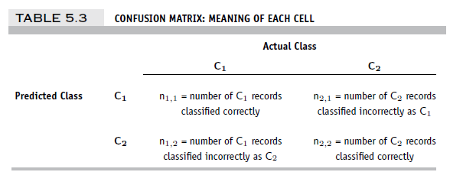
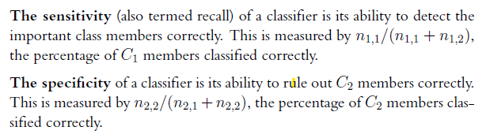
Alternate Accuracy Measures
Notes:
Suppose that it is more important to predict membership correctly in class C1 than in class C2. An example is predicting the financial status (bankrupt/solvent) of firms. It may be more important to predict correctly a firm that is going
bankrupt than to predict correctly a firm that is going to remain solvent. The classifier is essentially used as a system for detecting or signaling bankruptcy. In such a case, the overall accuracy is not a good measure for evaluating the classifier. Here Sensitivity and Specifity are used.
True Positive Rate (Sensitivity) vs. False Positive Rate: The ROC curve plots the trade-off between two key metrics:
True Positive Rate (TPR), also known as Sensitivity or Recall: This measures the proportion of actual positive instances that are correctly classified as positive by the model. It tells you how well the model identifies the positive class.
False Positive Rate (FPR): This measures the proportion of actual negative instances that are incorrectly classified as positive by the model. It tells you how often the model makes false alarms.

Slide 24
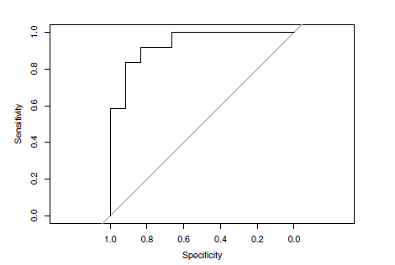
ROC Curve (library pROC)
Area under the ROC curve (“AUC”) is a useful metric
Diagonal reflects random classification on a sliding probability, from 0 to 1, of labeling a record as a “1”
Note that x-axis is in reverse order; alternative is to plot “1-specificity” in ascending order
Notes:
Suppose that it is more important to predict membership correctly in class C1 than in class C2. An example is predicting the financial status (bankrupt/solvent) of firms. It may be more important to predict correctly a firm that is going bankrupt than to predict correctly a firm that is going to remain solvent. The classifier is essentially used as a system for detecting or signaling bankruptcy. In such a case, the overall accuracy is not a good measure for evaluating the classifier.
The Receiver Operating Characteristic (ROC) curve is a graphical tool used to assess the performance of a binary classification model, such as a logistic regression model or a machine learning classifier. It's particularly useful when evaluating models that provide a probability score or a propensity score for classifying instances into one of two classes (positive or negative).
Here's how the ROC curve works and what it represents:
Binary Classification Problem: ROC curves are used for binary classification tasks where the goal is to classify data points into one of two classes, often referred to as the "positive" class and the "negative" class. Examples include medical diagnosis (disease or no disease) or spam email detection (spam or not spam).
True Positive Rate (Sensitivity) vs. False Positive Rate: The ROC curve plots the trade-off between two key metrics:
True Positive Rate (TPR), also known as Sensitivity or Recall: This measures the proportion of actual positive instances that are correctly classified as positive by the model. It tells you how well the model identifies the positive class.
False Positive Rate (FPR): This measures the proportion of actual negative instances that are incorrectly classified as positive by the model. It tells you how often the model makes false alarms.
Threshold Variation: The ROC curve is created by varying the classification threshold of the model. At each threshold, the TPR and FPR are computed, and a point is plotted on the curve. By sweeping through different thresholds, you get a series of points that make up the ROC curve.
Ideal ROC Curve: An ideal ROC curve hugs the top-left corner of the graph, indicating high TPR (sensitivity) and low FPR. In this case, the model is excellent at distinguishing between the two classes.
Area Under the Curve (AUC): The AUC is a single number that summarizes the overall performance of the model as represented by the ROC curve. AUC ranges from 0 to 1, where a higher AUC indicates better model performance. An AUC of 0.5 suggests a model performs no better than random guessing, while an AUC of 1 represents a perfect model.
Model Comparison: ROC curves are especially useful when comparing the performance of multiple models. The model with the higher AUC is generally considered better at distinguishing between the two classes.
In summary, the ROC curve provides a visual representation of a binary classification model's performance across different classification thresholds. It helps you understand the trade-off between correctly identifying positive instances and incorrectly classifying negative instances. The AUC summarizes this performance, making it a valuable tool for model evaluation and comparison.
Compute and Interpret AUC (Area Under the Curve)
AUC (Area Under the ROC Curve) is a single scalar value that summarizes the performance of your classifier.
Interpretation of AUC:
AUC = 1: Perfect classifier.
AUC > 0.9: Excellent model.
AUC between 0.8 and 0.9: Good model.
AUC between 0.7 and 0.8: Fair model.
AUC = 0.5: Model is no better than random guessing (i.e., no discrimination ability).
AUC < 0.5: This is rare and indicates the model is worse than random guessing, which usually points to an issue in the modeling process.
What to Do Next:
If the AUC is high (e.g., >0.8), the model is generally good at distinguishing between positive and negative classes.
If the AUC is low (e.g., <0.7), consider improving the model by:
Adding more features.
Using different algorithms.
Tuning hyperparameters.
Handling class imbalance (e.g., using SMOTE, undersampling, or adjusting class weights).

Slide 25

Lift (gains) (separating the “wheat from the chaff”)
Notes:
One real-life example for each of ROC, Lift Chart, and Accuracy to illustrate when each metric is most useful:
ROC Curve (Receiver Operating Characteristic):
Example: Medical Diagnostics
Scenario: Imagine a medical test for a rare disease where early detection is critical. You want to assess the performance of the diagnostic test.
Use of ROC: In this scenario, you use the ROC curve to evaluate the trade-off between Sensitivity (the ability to correctly identify individuals with the disease) and Specificity (the ability to correctly identify individuals without the disease) at various thresholds. ROC is valuable here because you can choose the threshold that balances the need for high sensitivity with an acceptable level of specificity. This helps in deciding the optimal cutoff for diagnosis, considering the seriousness of false negatives and false positives.
2. Lift Chart (Cumulative Gains Chart):
Example: Marketing Campaign
Scenario: A marketing team is launching a new product and wants to target a limited budget towards customers most likely to purchase.
Use of Lift Chart: The marketing team uses a predictive model to identify potential customers. They create a lift chart to understand how well the model performs in ranking customers by their likelihood to purchase. The lift chart allows them to see how many positive responses (e.g., purchases) they can expect to capture by targeting a certain percentage of the top-ranked customers. It helps in optimizing the allocation of resources and budget for the marketing campaign.
3. Accuracy:
Example: Email Spam Detection
Scenario: You are developing a spam filter for email. The goal is to correctly classify incoming emails as either spam or not spam.
Use of Accuracy: In this context, accuracy is often used as a straightforward measure of how well the spam filter is performing. A high accuracy percentage means that a large portion of emails are correctly classified. Since the cost of missing a spam email (false negative) and incorrectly flagging a legitimate email as spam (false positive) may be roughly equal for most users, accuracy provides a simple, overall measure of the filter's correctness. However, it's important to note that accuracy may not be the only metric considered when fine-tuning such a filter.
These examples illustrate how ROC, Lift Charts, and Accuracy can be applied in different real-life scenarios to assess the performance of classification models based on the specific goals and trade-offs involved in each case.

Slide 26
Lift (also termed “gains”): Goal
Evaluates how well a model identifies the most important class
Helps evaluate, e.g.,
How many tax records to examine
How many loans to grant
How many customers to mail offer to

Slide 27
Lift (gains) and Decile Charts – Cont.
Compare performance of DM model to “no model, pick randomly”
Measures ability of DM model to identify the important class, relative to the average prevalence of the class
Charts give explicit assessment of results over a large number of cutoffs
Notes:
27

Slide 28
Lift and Decile Charts: How to Use
Sort records by predicted probability of belonging to the important class (“1’s”)
Move down the list, noting actual class
As you go, compare the number of actual 1’s to the number of 1’s you would expect with no model
In lift chart: compare step function to straight line
In decile chart compare to ratio of 1
Notes:
28

Slide 29
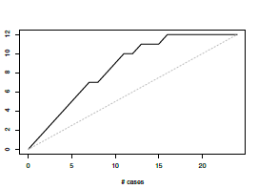
Lift (Gains) Chart – cumulative performance (using R “Gains” package)
After examining (e.g.,) 10 cases (x-axis), 9 owners (y-axis) have been correctly identified

Slide 30
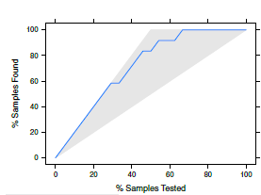
Lift (Gains) Chart – cumulative performance R “caret” package uses %
“Sample” = case
After examining (e.g.,) 40% = 10 of the cases (x-axis), 75% of the owners (y-axis) have been correctly identified

Slide 31
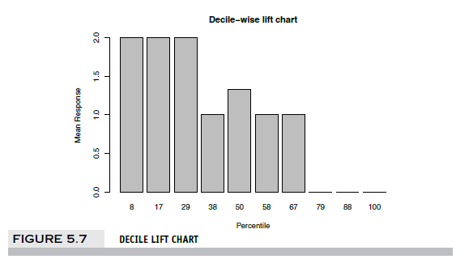
Decile Chart
In “most probable” (top) decile, model is twice as likely to identify the important class compared to avg. prevalence. Percentiles do not match deciles exactly due to small sample of discrete data, with multiple records sharing same decile boundary.

Slide 32
Lift (Gains): How to Compute
Using the model’s output, sort records from most likely to least likely members of the important class
Compute lift: Accumulate the correctly classified “important class” records (Y axis) and compare to number of total records (X axis)

Slide 33
Lift vs. Decile Charts
Both embody concept of “moving down” through the records, starting with the most probable 1’s
Decile chart does this in decile chunks of data
Y axis shows ratio of decile mean to overall mean
Lift chart shows continuous cumulative results
Y axis shows number of important class records identified
Notes:
33

Slide 34

Asymmetric Costs

Slide 35
Misclassification Costs May Differ
The cost of making a misclassification error may be higher for one class than the other(s)
Looked at another way, the benefit of making a correct classification may be higher for one class than the other(s)

Slide 36
Example – Response to Promotional Offer
Suppose we send an offer to 1000 people, with 1% average response rate (“1” = response, “0” = nonresponse)
“Naïve rule” (classify everyone as “0”) has error rate of 1% (seems good)
Using DM we can correctly classify eight 1’s as 1’s
It comes at the cost of misclassifying twenty 0’s as 1’s and two 1’s as 0’s.

Slide 37
The Confusion Matrix
The Confusion Matrix*
 | Actual 0 | Actual 1
Predicted 0 | 970 | 2
Predicted 1 | 20 | 8
Error rate = (2+20) = 2.2% (higher than naïve rate)
*confusion matrix is often shown with predictions as rows, actuals as columns, the reverse of what R produces

Slide 38
Introducing Costs & Benefits
Suppose:
Profit from a “1” is $10
Cost of sending offer is $1
Then:
Under naïve rule, all are classified as “0”, so no offers are sent: no cost, no profit
Under DM predictions, 28 offers are sent.
8 respond with profit of $10 each
20 fail to respond, cost $1 each
972 receive nothing (no cost, no profit)
Net profit = $60

Slide 39
Profit Matrix
 | Actual 0 | Actual 1
Predicted 0 | $0 | $0
Predicted 1 | ($20) | $80

Slide 40
Lift (again)
Adding costs to the mix, as above, does not change the actual classifications
Better: Use the lift curve and change the cutoff value to maximize profit
Notes:
"Adding costs to the mix, as above, does not change the actual classifications":
This statement means that incorporating costs (e.g., the cost of misclassification) into a classification problem doesn't alter the fundamental way the classifier assigns data points to classes. The classifier still makes predictions based on its algorithm and assigns each data point to one of the classes (e.g., "1" or "0").
"Better: Use the lift curve and change the cutoff value for '1' to maximize profit":
This statement suggests a more effective approach to decision-making when costs are involved. Instead of solely relying on the default cutoff value for classifying data points (typically 0.5 in binary classification), you can use the lift curve.
The lift curve displays how much better your model is at identifying the positive class compared to random chance as you vary the cutoff threshold. It helps you understand the trade-off between true positives and false positives at different cutoff points.
To maximize profit or minimize costs, you can adjust the cutoff value for class "1" (positive class) along the lift curve. By doing so, you can choose a cutoff that balances the benefits (true positives) and costs (false positives) to optimize the overall outcome, such as maximizing profit.
In summary, the key idea is that when dealing with classification problems involving costs or profits, you can use the lift curve to identify the optimal cutoff value for classifying data points as "1" (positive class). This allows you to make decisions that take into account the trade-offs between true positives and false positives, leading to better outcomes in terms of cost-effectiveness or profit maximization.

Slide 41
Generalize to Cost Ratio
Sometimes actual costs and benefits are hard to estimate
Need to express everything in terms of costs (i.e., cost of misclassification per record)
Goal is to minimize the average cost per record
A good practical substitute for individual costs is the ratio of misclassification costs (e,g,, “misclassifying fraudulent firms is 5 times worse than misclassifying solvent firms”)
Notes:
Minimizing Cost Ratio (q1/q0): Initially, you may calculate or evaluate the cost ratio (q1/q0) to understand the relative costs of misclassifying the positive and negative classes. This helps you assess the cost imbalance between the classes and informs your decision-making.
Minimizing Average Cost per Record: Based on the cost ratio and your understanding of the cost structure, you can then choose a cutoff threshold for classification that minimizes the overall average cost per record. This threshold is selected to optimize the trade-off between the costs of misclassifying both positive and negative cases.

Slide 42
Minimizing Cost Ratio
q₁ = cost of misclassifying an actual “1”,
q₀ = cost of misclassifying an actual “0”
Minimizing the cost ratio q₀/q₁ is identical to
minimizing the average cost per record
Software may provide option for user to specify cost ratio
Notes:
42

Slide 43
Note: Opportunity costs
As we see, best to convert everything to costs, as opposed to a mix of costs and benefits
E.g., instead of “benefit from sale” refer to “opportunity cost of lost sale”
Leads to same decisions, but referring only to costs allows greater applicability

Slide 44
Multiple Classes
For m classes, confusion matrix has m rows and m columns
Theoretically, there are m(m-1) misclassification costs, since any case could be misclassified in m-1 ways
Practically too many to work with
In decision-making context, though, such complexity rarely arises – one class is usually of primary interest

Slide 45
Adding Cost/Benefit to Lift Curve
Sort records in descending probability of success
For each case, record cost/benefit of actual outcome
Also record cumulative cost/benefit
Plot all records
X-axis is index number (1 for 1st case, n for n^{th} case)
Y-axis is cumulative cost/benefit
Reference line from origin to y_{n} ( y_{n} = total net benefit)

Slide 46
Lift Curve May Go Negative
If total net benefit from all cases is negative, reference line will have negative slope
Nonetheless, goal is still to use cutoff to select the point where net benefit is at a maximum
Notes:
The procedure is then as follows:
1. Sort the records in descending order of predicted probability of success
(where success = belonging to the class of interest).
2. For each record, record the cost (benefit) associated with the actual outcome.
3. For the highest propensity (i.e., first) record, its x-axis value is 1 and its
y-axis value is its cost or benefit (computed in Step 2) on the lift curve.
4. For the next record, again calculate the cost (benefit) associated with the
actual outcome. Add this to the cost (benefit) for the previous record.
This sum is the y-axis coordinate of the second point on the lift curve.
Its x-axis value is 2.
5. Repeat Step 4 until all records have been examined. Connect all the
points, and this is the lift curve.
6. The reference line is a straight line from the origin to the point y = total
net benefit and x = n(n = number of records).
Note: It is entirely possible for a reference line that incorporates costs and benefits
to have a negative slope if the net value for the entire dataset is negative. For
example, if the cost of mailing to a person is $0.65, the value of a responder is
$25, and the overall response rate is 2%, the expected net value of mailing to a list
of 10,000 is (0:02$2510; 000)􀀀($0:6510; 000) = $5000􀀀$6500 =
􀀀$1500. Hence, the y-value at the far right of the lift curve (x = 10,000) is
􀀀1500, and the slope of the reference line from the origin will be negative. The
optimal point will be where the lift curve is at a maximum (i.e., mailing to about
3000 people) in Figure

Slide 47
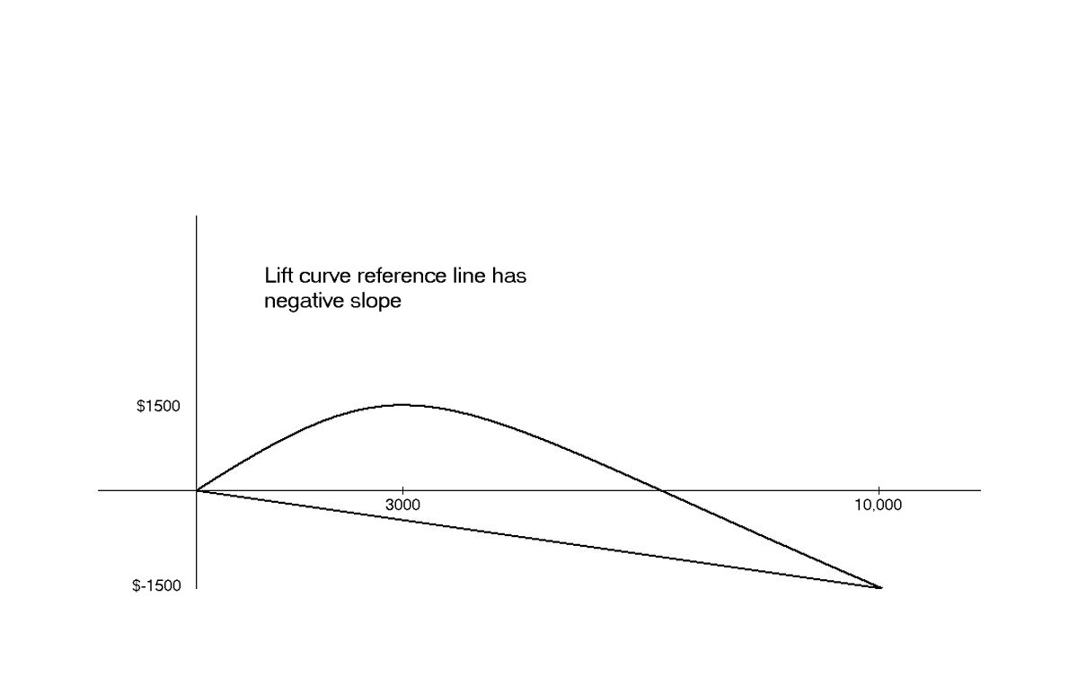
Negative slope to reference curve
Notes:
For example, if the cost of mailing to a person is $0.65, the value of a responder is $25, and the overall response rate is 2%, the expected net value of mailing to a list of 10,000 is (0.02 * $25 * 10,000) – ($0.65 * 10,000) = $5000 - $6500 = -1500. Hence, the y-value at the far right of the lift curve (x = 10,000) is -1500, and the slope of the reference line from the origin will be negative. The optimal point will be where the lift curve is at a maximum (i.e., mailing to about 3000 people) in the figure

Slide 48
Oversampling and Asymmetric Costs
Notes:
Stratified sampling is a sampling technique used in statistics and research to ensure that a representative sample is drawn from a population, especially when the population has distinct subgroups or strata. This method involves dividing the population into homogeneous subgroups (strata) based on certain characteristics and then randomly selecting samples from each stratum. The goal is to ensure that the sample reflects the diversity of the population.
Here's how stratified sampling works:
Identify Strata: First, you need to identify relevant subgroups (strata) within the population. These subgroups should share common characteristics or attributes that are important for your analysis. For example, if you are conducting a survey of students, you might create strata based on grade level (e.g., freshman, sophomore, junior, senior) or major (e.g., science, humanities, engineering).
Determine Sample Size: Decide on the desired sample size for your study. You may allocate a proportionate or fixed number of samples to each stratum, depending on the importance of each subgroup and the overall goals of your research.
Random Sampling: Within each stratum, use random sampling techniques to select samples. This ensures that each individual within a stratum has an equal chance of being selected. You can use simple random sampling or more complex methods like systematic sampling or stratified random sampling.
Aggregate Samples: Combine the samples from all strata to form your final stratified sample. This sample should represent the entire population while maintaining the proportional representation of each subgroup.
Stratified sampling offers several advantages:
Improved Representation: By considering the characteristics of different subgroups, stratified sampling provides a more accurate representation of the population, especially when there is variation within the population.
Efficiency: It can be more efficient than simple random sampling when some subgroups are small or rare. Stratified sampling ensures that even small groups are adequately represented in the sample.
Comparisons: It allows for meaningful comparisons between subgroups because each stratum is represented in the sample.
Precision: In certain cases, stratified sampling can lead to more precise estimates or predictions because it accounts for the variation within each stratum.
Stratified sampling is commonly used in various fields, including market research, opinion polling, medical studies, and social sciences, whenever there is a need to ensure that the sample accurately reflects the diversity of the population being studied.

Slide 49
Rare Cases
Asymmetric costs/benefits typically go hand in hand with presence of rare but important class
Responder to mailing
Someone who commits fraud
Debt defaulter
Often we oversample rare cases to give model more information to work with
Typically use 50% “1” and 50% “0” for training
Notes:
Why Use a 50-50 Split?:
In extreme cases of class imbalance (e.g., 99% majority class and 1% minority class), you might choose to oversample the rare class to achieve a 50% positive class and 50% negative class in the training data. This is done to ensure the model has enough examples of both classes to learn from.
With a 50-50 split, the model treats both classes as equally important during training, which can lead to better performance in detecting rare cases.

Slide 50
Example
Following graphs show optimal classification under three scenarios:
assuming equal costs of misclassification
assuming that misclassifying “o” is five times the cost of misclassifying “x”
Oversampling scheme allowing DM methods to incorporate asymmetric costs

Slide 51
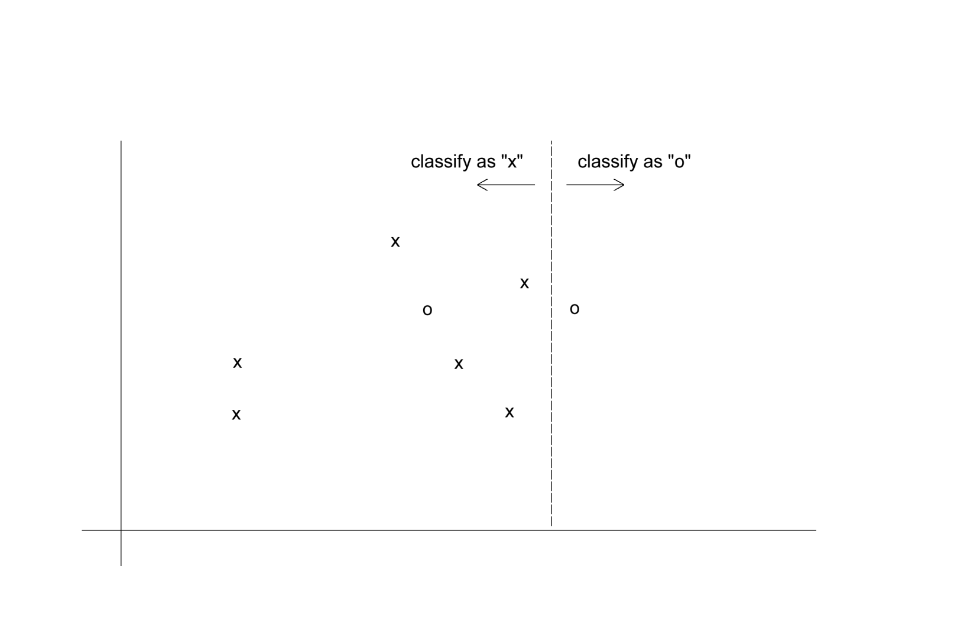
Classification: equal costs
Notes:
Consider the data in Figure 5.9, where represents non-responders, and ◦,
responders. The two axes correspond to two predictors. The dashed vertical line
does the best job of classification under the assumption of equal costs: It results
in just one misclassification (one ◦ is misclassified as an ). If we incorporate
more realistic misclassification costs—let’s say that failing to catch a ◦ is five times
as costly as failing to catch an —the costs of misclassification jump to 5. In
such a case, a horizontal line as shown in Figure 5.10, does a better job: It results
in misclassification costs of just 2.

Slide 52
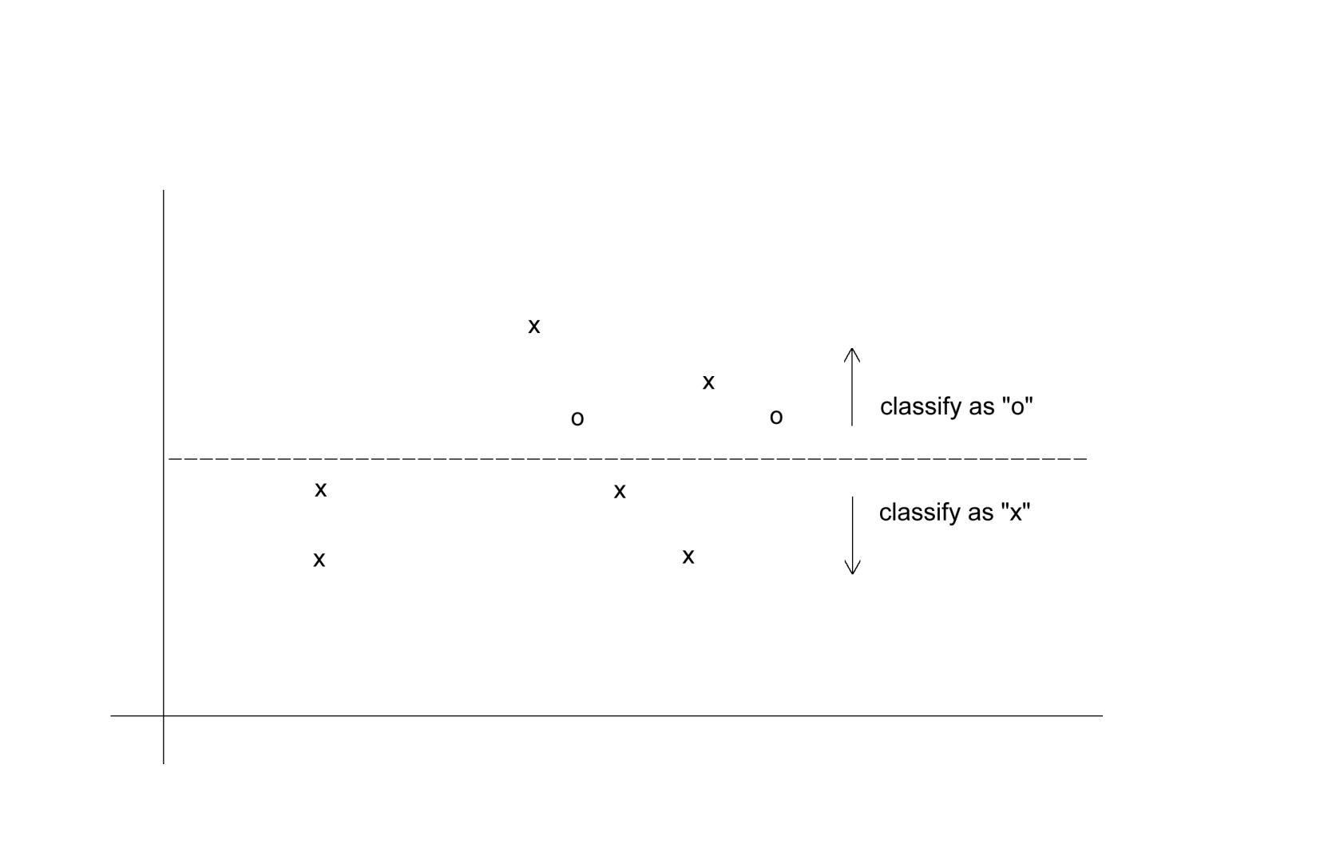
Classification: Unequal costs

Slide 53
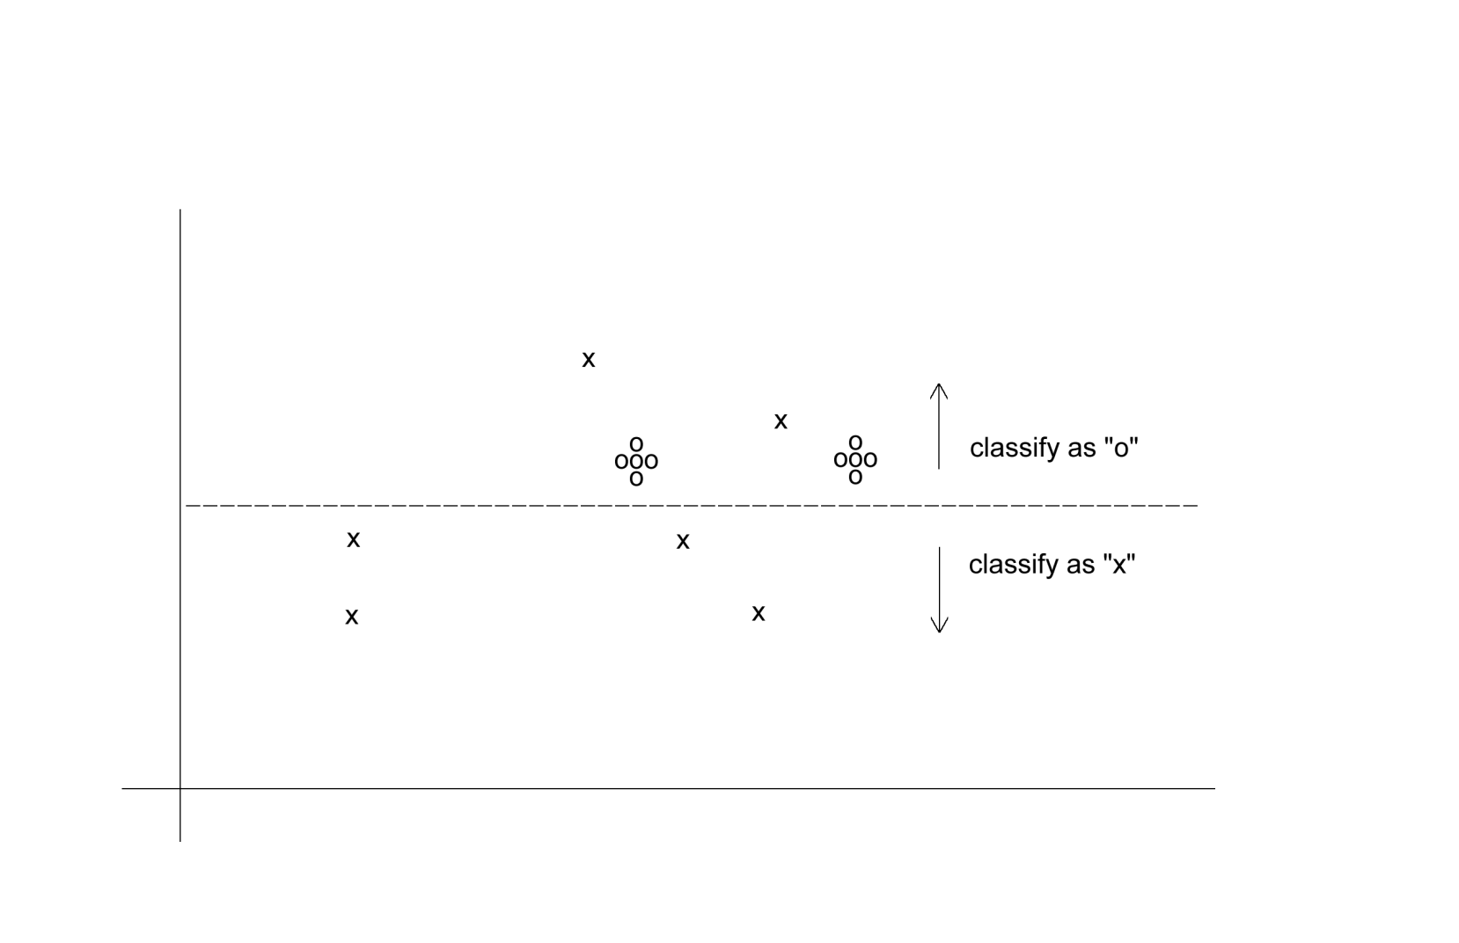
Oversampling Scheme
Oversample “o” to appropriately weight misclassification costs
Notes:
Oversampling is one way of incorporating these costs into the training process. In Figure 5.11, we can see that classification algorithms would automatically determine the appropriate classification line if four additional ◦’s were present at each existing ◦. We can achieve appropriate results either by taking five times as many ◦’s as we would get from simple random sampling (by sampling with replacement if necessary), or by replicating the existing ◦’s fourfold.

Slide 54
An Oversampling Procedure
Separate the responders (rare) from non-responders
Randomly assign half the responders to the training sample, plus equal number of non-responders
Remaining responders go to validation sample
Add non-responders to validation data, to maintain original ratio of responders to non-responders
Randomly take test set (if needed) from validation

Slide 55
Classification Using Triage
Take into account a gray area in making classification decisions
Instead of classifying as C₁ or C₀, we classify as
C₁
C₀
Can’t say
The third category might receive special human review
Notes:
In some cases, it is useful to have two cutoffs, and allow a “cannot say” option for
the classifier. In a two-class situation, this means that for a record, we can make
one of three predictions: The record belongs to C1, or the record belongs to C2,
or we cannot make a prediction because there is not enough information to pick
C1 or C2 confidently. Records that the classifier cannot classify are subjected to
closer scrutiny either by using expert judgment or by enriching the set of predictor
variables by gathering additional information that is perhaps more difficult or
expensive to obtain. An example is classification of documents found during legal
discovery (reciprocal forced document disclosure in a legal proceeding). Under traditional
human-review systems, qualified legal personnel are needed to review what
might be tens of thousands of documents to determine their relevance to a case.
Using a classifier and a triage outcome, documents could be sorted into clearly relevant,
clearly not relevant, and the gray area documents requiring human review.
This substantially reduces the costs of discovery.

Slide 56
Summary
Evaluation metrics are important for comparing across DM models, for choosing the right configuration of a specific DM model, and for comparing to the baseline (“no model”)
Major metrics: confusion matrix, error rate, predictive error
Other metrics when
one class is more important
asymmetric costs
When important class is rare, use oversampling
In all cases, metrics computed from validation data

